Slide 1
Chapter 10
One-Way Analysis of Variance (ANOVA)

Slide 2
Learning Objectives
Describe the concept of one-way ANOVA
Explain the principle and main assumptions of one-way ANOVA
Design the experiments in one-way ANOVA
Frame hypotheses for completely randomized design (CRD) and randomized block design (RBD)
Explain the statistical significance of one-way ANOVA

Slide 3
Describe the application of priori and posteriori contrasts in ANOVA
Demonstrate the steps used in SPSS to execute CRD and RBD experiments
Explain how to analyse and interpret SPSS outputs
Describe the important formulae and calculations of CRD and RBD ANOVA tables
Report the final results of CRD and RBD experiments

Slide 4
Introduction
Analysis of Variance (ANOVA) is a parametric test procedure which compares several population means, aiming to ascertain statistical difference.
The term ‘analysis of variance’ is used to compare the variance of samples to make inferences about the means.
One-way ANOVA is used to test hypothesis, where one dependent variable is measured at continuous scale (interval or ratio) and one independent variable is categorical in nature or in few cases ordinal scale with minimum three distinct levels.
This independent variable is called ‘single-factor’ and each category of independent variable is referred as ‘level’. Each level of independent variable represents ‘unique treatment’ in one-way ANOVA and the effects of treatment can be measured on particular dependent variable.

Slide 5
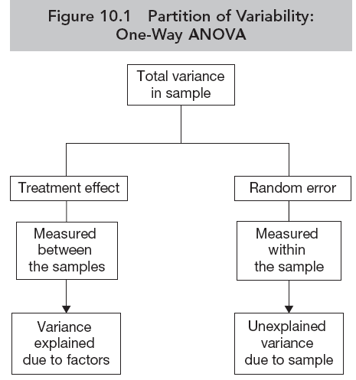
Principle of One-Way ANOVA
The partition of this total variability is schematically presented as shown in Figure 10.1.
The relative difference in variance components leads to decide whether to reject the null hypothesis of ‘no difference condition’ among the sample means.

Slide 6
Source of Variance
Table 10.1. One-Way ANOVA: F-Ratio
Source of Variance | Cause of Variability | Degree of Freedom (df) | Sum of Squares (SS) | Mean Sum of Squares (MS) | F-Statistics
Between group | Treatment effect | k−1 | SSC | MSC = SSC/k−1 | F ratio = MSC/MSE
Within group | Random error or sample fluctuation | n−k | SSE | MSE = SSE/n−k
Total variance | Difference of individual observation | n−1 | SST

Slide 7
Assumptions for One-Way ANOVA
Fixed-effects model: The inferences made in one-way ANOVA are fixed to the number of categories as specified for independent variable.
Normal distributed population: The target population is normal distributed.
Independence of error: The random selection of samples from the normal population is an important assumption.
Homogeneity of variance: The groups should have equal variance as reflected in the distribution and carries same mean, shape and variance.
Data scale: The dependent variable(s) used as test variable in the analysis should be measured as continuous scale.

Slide 8
Summary of Assumptions
Table 10.2. Assumptions of One-Way ANOVA
Assumptions | Examine Approach | Measures/Tests
Fixed-effects model | Methodological | Distinct categories used in experiment
Normal distribution | Graphical method | Histogram, Q–Q plots, P–P plots and Box and Whisker plot
 | Numerical method | Skewness and kurtosis
 |  | KS one sample and Shapiro–Wilk
Independence of error | Methodological | Random selection of sample
Homogeneity of variance | Numerical method | Levene’s test
Data scale | Methodological | Dependent variable: Interval or ratio scales
 |  | Independent variable: Nominal

Slide 9
Framing Hypothesis
Null hypothesis
H₀: µ₁ = µ₂ = µ_{3 ………..} µ_{k} (k = Number of levels)
(The population mean is same in all the groups.)
We can also display particular method or treatment in null hypothesis associated to each level such as
H₀: µ_{treatment1} = µ_{treatment2} = µ_{treatment3 ……} µ_{treatment k}
Alternative hypothesis H_{a}: µ₁ ≠ µ₂ ≠ µ₃ ≠ …….. µ_{k}
(The population mean is not same in all the groups.)

Slide 10
Statistical Significance in One-Way ANOVA
A total variance in one-way ANOVA is partitioned into variance between the groups and with-in groups.
In ANOVA, F-ratio is computed as dividing variance between the groups by with-in group.
The variance between groups is accounted by the treatment effect in the experiment.
Hence, larger F-ratio represents significant difference among means due to substantial effect of treatments.

Slide 11
Priori Contrast
The contrast analysis is used for comparing the specific treatment group means before running the experiment. Hence, it is called priori or planned contrast.
Table 10.3. Increasing Probability of Type I Error
Number of Means | Number of t-tests | Probability of Type I Error | Formula Used
2 | 1 | 0.05 | 1−(1−0.05)¹
3 | 3 | 0.142 | 1−(1−0.05)³
4 | 6 | 0.265 | 1−(1−0.05)⁶
5 | 10 | 0.401 | 1−(1−0.05)¹⁰
6 | 15 | 0.537 | 1−(1−0.05)¹⁵
7 | 21 | 0.659 | 1−(1−0.05)²¹

Slide 12
In order to maintain the type I error rate at pre-established LoS, one-way ANOVA technique is the better option.
By applying this method, type I error rate is established for the entire set of comparisons.

Slide 13
Posteriori Contrast or Multiple Comparison Tests
The multiple comparison tests are related to post hoc or posteriori contrast and are conducted after computing the facts through one-way ANOVA in study. These tests are used to ascertain whether any unexpected mean difference occurs in a particular pair after testing the null hypothesis with standardized result of one-way ANOVA.

Slide 14
Table 10.4. Post Hoc Test: Multiple Comparison
Post-hoc method | Number of Observations in Each Group | Comparison Pattern | Require Significant F­-ratio | Protection
Fisher’s PLSD | Equal | All possible pairs | Yes | More sensitive to Type-I
Tukey–Kramer HSD | Equal | All possible pairs | Yes | Less sensitive to Type-I than PLSD
Scheffe test | Un-equal | All possible pairs | No | Most conservative
Bonferroni test | Un-equal | Some pairs | Yes | Less conservative
Games–Howell | Un-equal | All possible pairs | No | More conservative
Source: Hilton and Armstrong , 2006

Slide 15
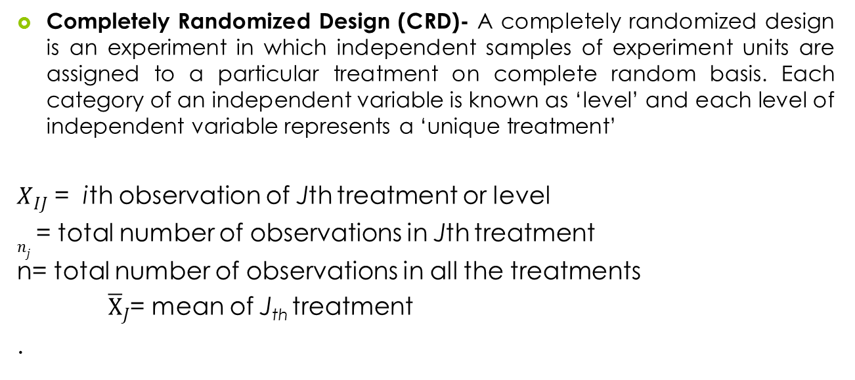
Designing Experiments in One-Way ANOVA

Slide 16
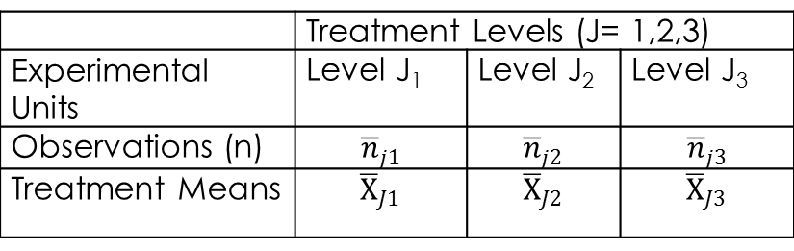
Table 10.5. Layout of Completely Randomized Design
 | Treatment Levels (J = 1,2,3)
Experimental units | Level J₁ | Level J₂ | Level J₃
Observations (n)
Treatment means

Slide 17
Executing Completely Randomized Design with SPSS
In this experiment, the focus on determining whether the ratings of quality (measured on 10-point scale; 1 = completely dissatisfied, 10 = completely satisfied) of three coffee drinks differ across 105 customers in a geographical area (data set: coffee_drinks.sav).
Thirty-five respondents rated to each coffee drink for the measurement. In this experiment, we assigned three treatments (J = 1, 2 and 3) randomly to 105 experimental units (n₁ + n₂ + n₃ = 105) for measuring the observations from three experimental groups (G_{1,} G₂ and G₃).

Slide 18
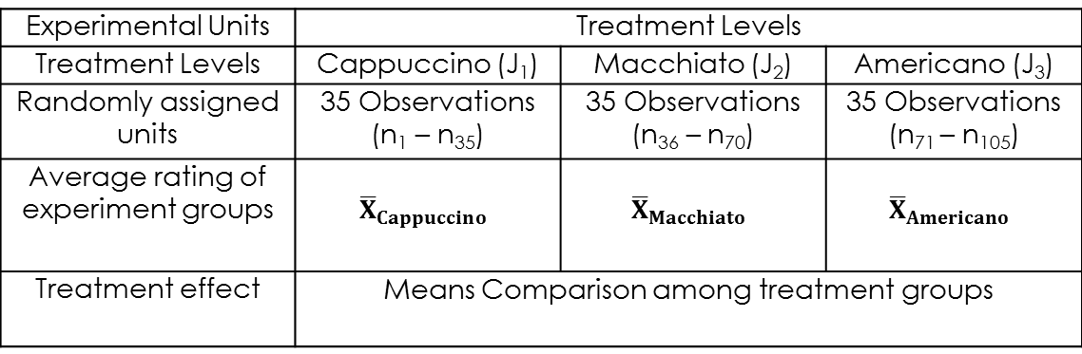
Table 10.6. Treatment Levels: Means Comparison
Experimental Units | Treatment Levels
Treatment levels | Cappuccino (J₁) | Macchiato (J₂) | Americano (J₃)
Randomly assigned units | 35 Observations (n₁–n₃₅) | 35 Observations (n₃₆–n₇₀) | 35 Observations (n₇₁–n₁₀₅)
Average rating of experiment groups
Treatment effect | Means comparison among treatment groups

Slide 19
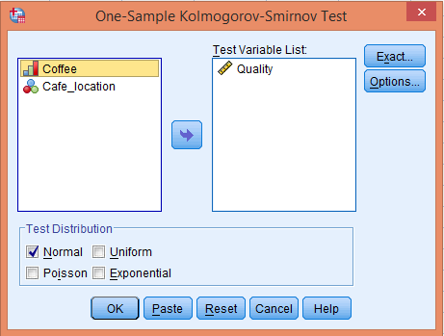
Assessing Normality
Exhibit 10.1. Use coffee_drinks.sav » Menu bar » analyse » Non-parametric test » Legacy Dialogs » One-sample KS test » Quality transfer to Test Variable(s) List » Click on Normal distribution under Test Distribution » Click OK

Slide 20
Table 10.7. Assessing Normality with One-Sample KS
 | N | Normal Parameters |  | K-S Z | Sig. (2-tailed)
 |  | Mean | Std. Deviation
Quality | 105 | 5.5 | 2.84 | 0.085 | 0.06
The p-value is more than 0.05 (p > 0.05, 0.06 at 5% LoS). We fail to reject the null hypothesis representing the condition of normality and conclude that ratings of quality is normal distributed among all treatment groups.

Slide 21
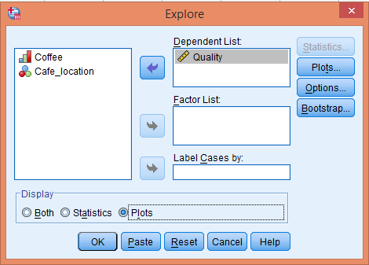
Graphical Display of Normality
Exhibit 10.2. Use coffee_drinks.sav » Menu bar » analyse » Descriptive statistics » Explore » Select Quality and transfer to Dependent List box » Select Plots under Display box » Plots » Continue » Click OK

Slide 22
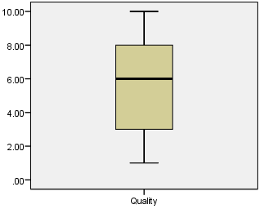
Fairly symmetric distribution of quality in experimental groups.

Slide 23
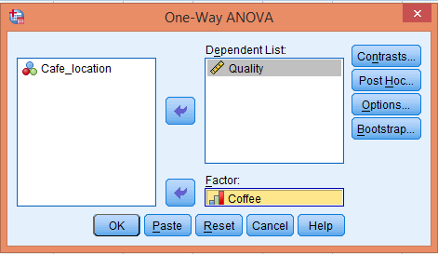
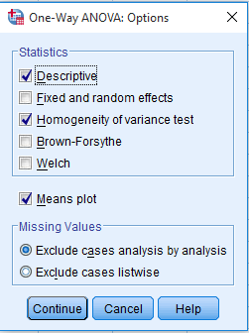
SPSS Path for Computing Descriptive Statistics, Homogeneity Test and ANOVA Statistics
Exhibit 10.3. Use coffee_drinks.sav » analyse » Compare means » One-way ANOVA » Select » Quality and transfer to Dependent List » Select Coffee and transfer to Factor » Options » Click Descriptive, Homogeneity of variance and Means plot » Click OK

Slide 24
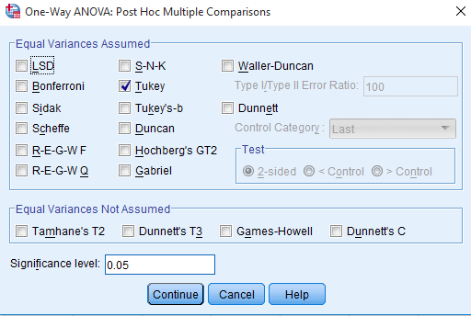
SPSS Path for Computing Pair-wise Comparison
Exhibit 10.4. Click Post Hoc » Select » Age and Transfer in box Post Hoc Tests for » Select Tukey as test of Equal Variance Assumed » Continue

Slide 25
Interpreting Outputs of One-Way ANOVA
Descriptors for Treatment Groups
Table 10.8a. Descriptive Statistics: CRD
 | N | Mean | Std. Deviation | Std. Error | 95% Confidence Interval for Mean
 |  |  |  |  | Lower Bound | Upper Bound
Cappuccino | 35 | 5.6 | 2.9 | 0.49 | 4.5 | 6.6
Macchiato | 35 | 4.7 | 2.5 | 0.42 | 3.8 | 5.5
Americano | 35 | 6.2 | 2.9 | 0.49 | 5.2 | 7.2

Slide 26
Equality of Variance
Table 10.8b. Homogeneity of Variance: CRD
A p-value (0.490) is more than 0.05 (at 5% LoS), hence we fail to reject the null hypothesis, which stated that the variability for the two groups are equal.
Levene’s Statistic | Df1 | Df2 | Sig.
0.71 | 2 | 102 | 0.490

Slide 27
ANOVA Statistics and Calculations for Sum of Squares, Degrees of Freedom, Mean Sum of Squares and F-Ratios
Null hypothesis H₀: µ_{Cappuccino} = µ_{Macchiato} = µ_{Americano}
(Satisfaction for quality is same among all the experimental groups.)
Alternative hypothesis H_{a}: µ_{cappuccino} ≠ µ_{Macchiato} ≠ µ_{Americano}
(Satisfaction for quality is not same among all the experimental groups.)

Slide 28
Table 10.8c. ANOVA Statistics: CRD
 | Sum of Squares | df | Mean Square | F | Sig.
Between-groups | 40.5 | 2 | 20.2 | 2.5 | 0.081
Within-groups | 803.7 | 102 | 7.8
Total | 844.2 | 104

Slide 29
The p-value (appears at last column) associated with F-statistics is more than 0.05 [F(2,104) = 0.081, p > 0.05, 2.5)] at 5 per cent LoS.
Hence, we fail to reject the null hypothesis of equal treatment effect among experimental groups and conclude that no significant difference exists in quality of three different levels of coffee drinks among the experimental groups.

Slide 30
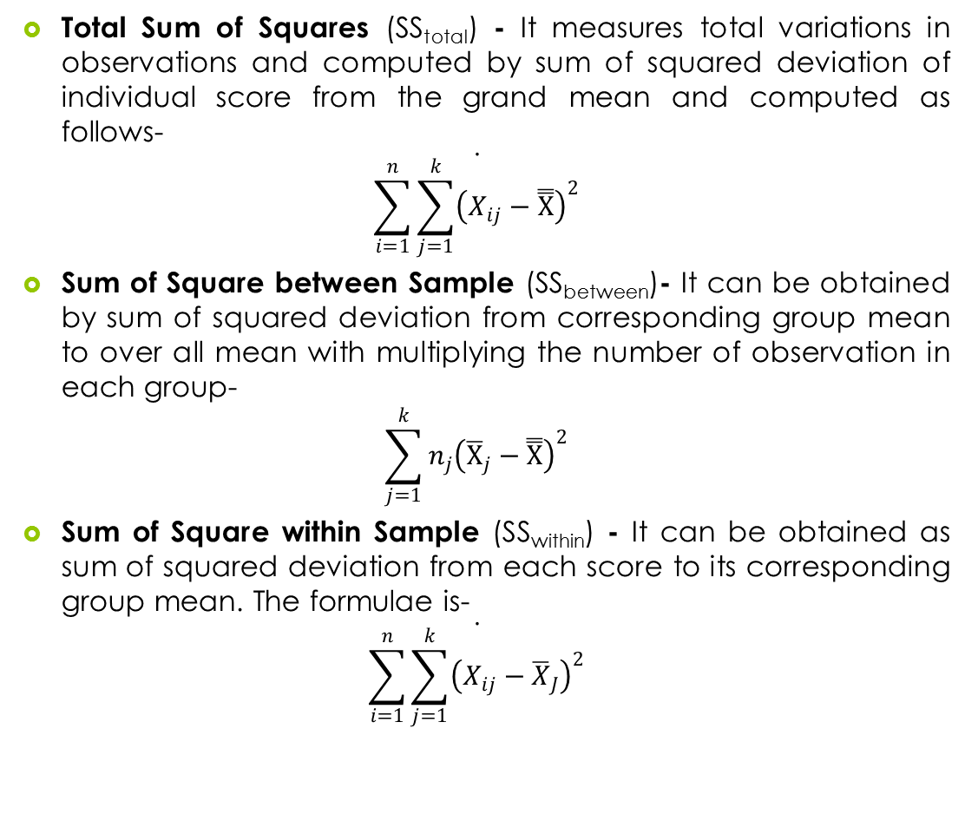
Important Calculations in One-Way ANOVA Table

Slide 31
Computing Degrees of Freedom
Table 10.9. Degrees of Freedom: CRD
Variation Source | Formulae for Degrees of Freedom | df
Between the sample | Number of treatment groups − 1, (k−1) | 3−1 = 2
Within the sample | Number of observations − treatment groups, (n−k) | 105−3 =102
Total variance | Number of observations − 1, (n−1) | 105−1 =104

Slide 32
Computing Mean Sum of Squares and F-Ratios
Table 10.10. F-Ratio: CRD
Formulae of Mean Sum of Square | Value | Formulae of F-Ratio | Value
Ms_{between} = SS_{between}/df | 40.5/2 = 20.5 | F = MS_{between}/ Ms_{within} | 20.7/7.8 = 2.65
Ms_{within} = SS_{within}/df | 803.7/102 = 7.8

Slide 33
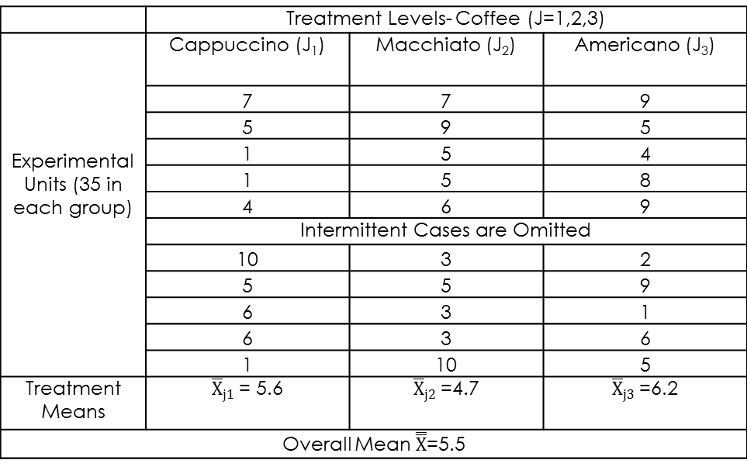
Sample Data Showing Mean Scores
Table 10.11. Different Mean Scores: CRD
 | Treatment Levels- Coffee (J = 1,2,3)
Experimental units (35 in each group) | Cappuccino (J₁) | Macchiato (J₂) | Americano (J₃)
 | 7 | 7 | 9
 | 5 | 9 | 5
 | 1 | 5 | 4
 | 1 | 5 | 8
 | 4 | 6 | 9
 | Intermittent cases are omitted
 | 10 | 3 | 2
 | 5 | 5 | 9
 | 6 | 3 | 1
 | 6 | 3 | 6
 | 1 | 10 | 5
Treatment means

Slide 34
Computing Multiple Comparison Tests
Table 10.12. Pair-wise Comparison of Treatment Group Means
Dependent Variable: Service Quality Tukey HSD
(I) Coffee | (J) Coffee | Mean Difference (I–J) | Std. Error | Sig. | 95% Confidence Interval
 |  |  |  |  | Lower Bound | Upper Bound
Cappuccino | Macchiato | 0.88 | 0.67 | 0.387 | −0.71 | 2.4
 | Americano | −0.62 | 0.67 | 0.618 | −2.2 | 0.96
Macchiato | Cappuccino | −0.88 | 0.67 | 0.387 | −2.4 | 0.71
 | Americano | −1.51 | 0.67 | 0.067 | −3.1 | 0.081
Americano | Cappuccino | 0.62 | 0.67 | 0.618 | −0.96 | 2.2
 | Macchiato | 1.51 | 0.67 | 0.067 | −0.08 | 3.1

Slide 35
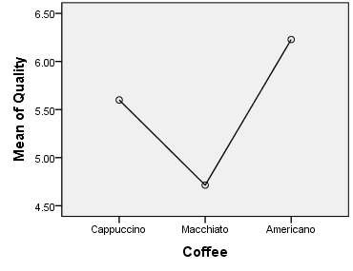
Visual Display: Mean Difference
We can easily interpret the closer means of Cappuccino (5.6) and Americano (6.2), as compared to Macchiato (4.7).

Slide 36
Reporting the Results of One-Way ANOVA (CRD)
Non-significant results of one-sample KS for quality (0.085, p > 0.05, 0.06) at 5 per cent LoS indicating the decision in favour of null hypothesis.
Similarly, non-significant F-statistic of treatment [F_{coffee drink} (2,104) = 2.5, p > 0.05, 0.081)] due to higher p-value than 5 per cent LoS infer the result in favour of null hypothesis of equal treatment effect. Thus, we conclude that quality of three coffee drinks is same among all the treatment groups.

Slide 37
Randomized Block Design (Single Block Factor)
The experiment design that isolates the effect of extraneous variable by the process of blocking is known as randomized block design (RBD).
The experiment design is laid out in such a way that similar independent test units are made to be a part of a particular ‘block’, and then in each block the treatments are assigned randomly to the test units.
The blocks are defined as heterogeneous sets of items that are matched and measured on repeated manner. The single blocking factor and treatment used in RBD are measured at nominal scale, whereas test units’ responses are measured at interval or ratio scale.

Slide 38
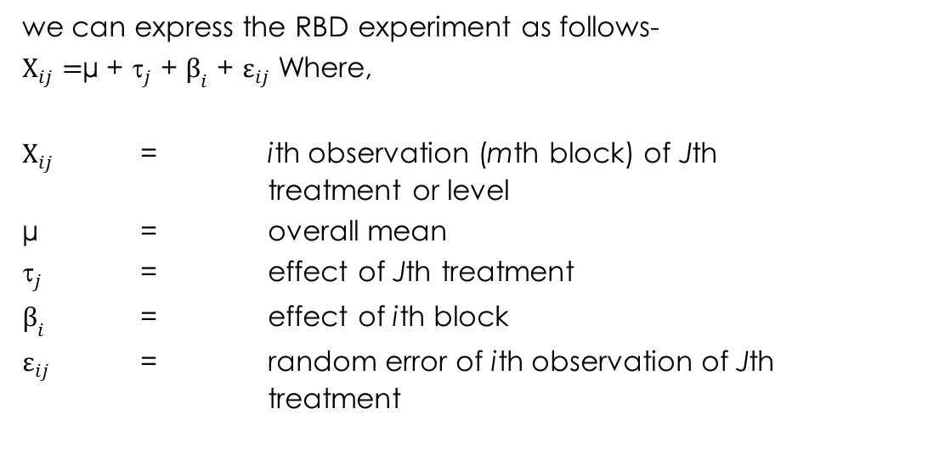

Slide 39
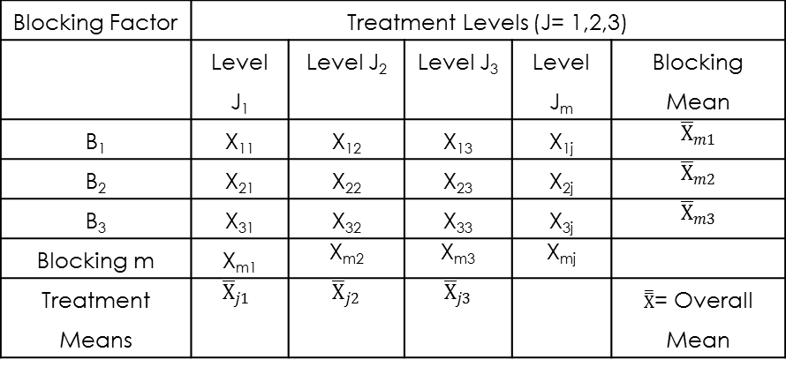
Table 10.13. Layout of Randomized Block Design
Blocking Factor | Treatment Levels (J = 1,2,3)
 | Level J₁ | Level J₂ | Level J₃ | Level J_{m} | Blocking Mean
B₁ | X₁₁ | X₁₂ | X₁₃ | X_{1j}
B₂ | X₂₁ | X₂₂ | X₂₃ | X_{2j}
B₃ | X₃₁ | X₃₂ | X₃₃ | X_{3j}
Blocking m | X_{m1} | X_{m2} | X_{m3} | X_{mj}
Treatment means

Slide 40
Research Problem and Test Technique
A data set coffee_drinks.sav is used to understand the randomized block design to determine whether the quality satisfaction (measured on 10-point rating scale; 1 = completely dissatisfied, 10 = completely satisfied) of three coffee drinks differ across 105 customers in a geographical area by blocking the effect of café location.
The location of a particular café (L₁ to L₅) could be used as blocks. In this experiment, we assume location as extraneous variable that affects the ratings of three different treatments (Cappuccino, Macchiato and Americano) for the experiment groups G₁ to G₃.

Slide 41
Executing Randomized Block Design with SPSS Procedure
SPSS Path for Computing Descriptive Statistics, Homogeneity Test and ANOVA Statistics
Exhibit 10.5. Use coffee_drinks.sav » analyse » General linear model » Univariate » Select » Quality and transfer to Dependent List » Select Coffee and cafe_location and transfer to Factor » Option » Select Coffee and cafe_location and transfer to Display means » Select Descriptive statistics and Homogeneity test from Display » Click OK

Slide 42
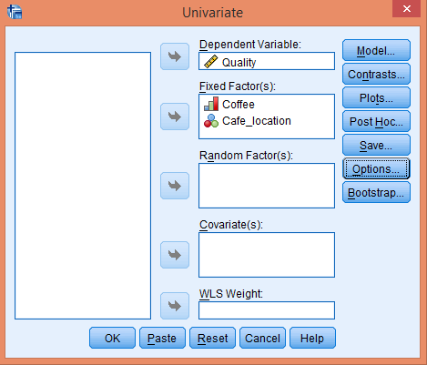
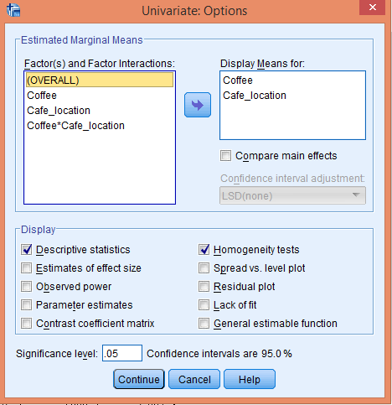

Slide 43
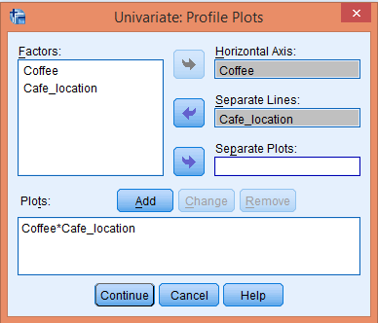
SPSS Path for Computing Profile Plot
Exhibit 10.6. Click Plots » Select » Coffee and transfer in Horizontal Axis » Select café_location and transfer in Separate Lines » Click on Add button

Slide 44
Interpreting Outputs of RBD
Observations of Cases
Table 10.14a. Observation Between-Test Factors
 |  | Value Label | Observations (N) |  |  | Value Label | Observations (N)
Treatment: Coffee Drinks | 1 | Cappuccino | 35 | Block: Café Location | 1 | L1 | 21
 | 2 | Macchiato | 35 |  | 2 | L2 | 21
 | 3 | Americano | 35 |  | 3 | L3 | 21
 |  |  |  |  | 4 | L4 | 21
 |  |  |  |  | 5 | L5 | 21

Slide 45
Block-wise Descriptive Statistics
Table 10.14b. Descriptive Statistics: RBD
F*1 | F**2 | Mean | Std. Deviation | N | F-1 | F-2 | Mean | Std. Deviation | N
Cappuccino | L1 | 7.2 | 2.0 | 7 | Americano | L1 | 5.7 | 2.9 | 7
 | L2 | 5.8 | 2.7 | 7 |  | L2 | 8.4 | 1.9 | 7
 | L3 | 5.0 | 1.9 | 7 |  | L3 | 3.2 | 3.2 | 7
 | L4 | 5.1 | 4.0 | 7 |  | L4 | 6.5 | 2.4 | 7
 | L5 | 4.7 | 3.4 | 7 |  | L5 | 7.1 | 1.7 | 7
 | Total | 5.6 | 2.9 | 35 |  | Total | 6.2 | 2.9 | 35
Macchiato | L1 | 5.7 | 2.0 | 7 | Total | L1 | 6.2 | 2.4 | 7
 | L2 | 5.4 | 2.7 | 7 |  | L2 | 6.5 | 2.7 | 7
 | L3 | 3.5 | 2.8 | 7 |  | L3 | 3.9 | 2.6 | 7
 | L4 | 3.1 | 1.9 | 7 |  | L4 | 4.9 | 3.1 | 7
 | L5 | 5.7 | 2.2 | 7 |  | L5 | 5.8 | 2.6 | 7
 | Total | 4.7 | 2.5 | 35 |  | Total | 5.5 | 2.8 | 35

Slide 46
Assumption of Homogeneity of Variance
Table 10.14c. Test of Equal Variance
Dependent Variable: Quality
F | df1 | df2 | Sig.
1.486 | 14 | 90 | 0.133
The non-significant p-value (p > 0.05, 0.133) at 5 per cent LoS verifies the assumption of homogeneity of variance in the target population.

Slide 47
ANOVA Statistics for Between-Subject Effects
Table 10.14d. Test Statistics for Between-Subject Effects: RBD
Dependent Variable: Quality
Source | Type III Sum of Squares | df | Mean Square | F | Sig.
Corrected model | 217.371ª | 14 | 15.5 | 2.2 | 0.012
Intercept | 3192.7 | 1 | 3192.7 | 458.3 | 0.000
Coffee | 40.5 | 2 | 20.25 | 2.90 | 0.060
Café location | 94.80 | 4 | 23.70 | 3.40 | 0.012
Coffee * Café location | 82.05 | 8 | 10.25 | 1.47 | 0.178
Error | 626.85 | 90 | 6.96
Total | 4037.0 | 105
Corrected total | 844.2 | 104
ªR Squared = 0.257 (Adjusted R Squared = .142)
−

Slide 48
In order to make the inferences, two null hypotheses for treatment and block are framed separately and expressed as follows:
Null hypothesis (Treatment)
H_{0Treatment}: µ_{Cappuccino} = µ_{Macchiato} = µ_{Americano}
(Quality satisfaction is same among all the experimental groups.)
Null Hypothesis (Block)
H_{0Block}: µ_{L1} = µ_{L2} = µ_{L3} = µ_{L4} = µ_{L5}
(Quality satisfaction is same for all the blocks.)

Slide 49
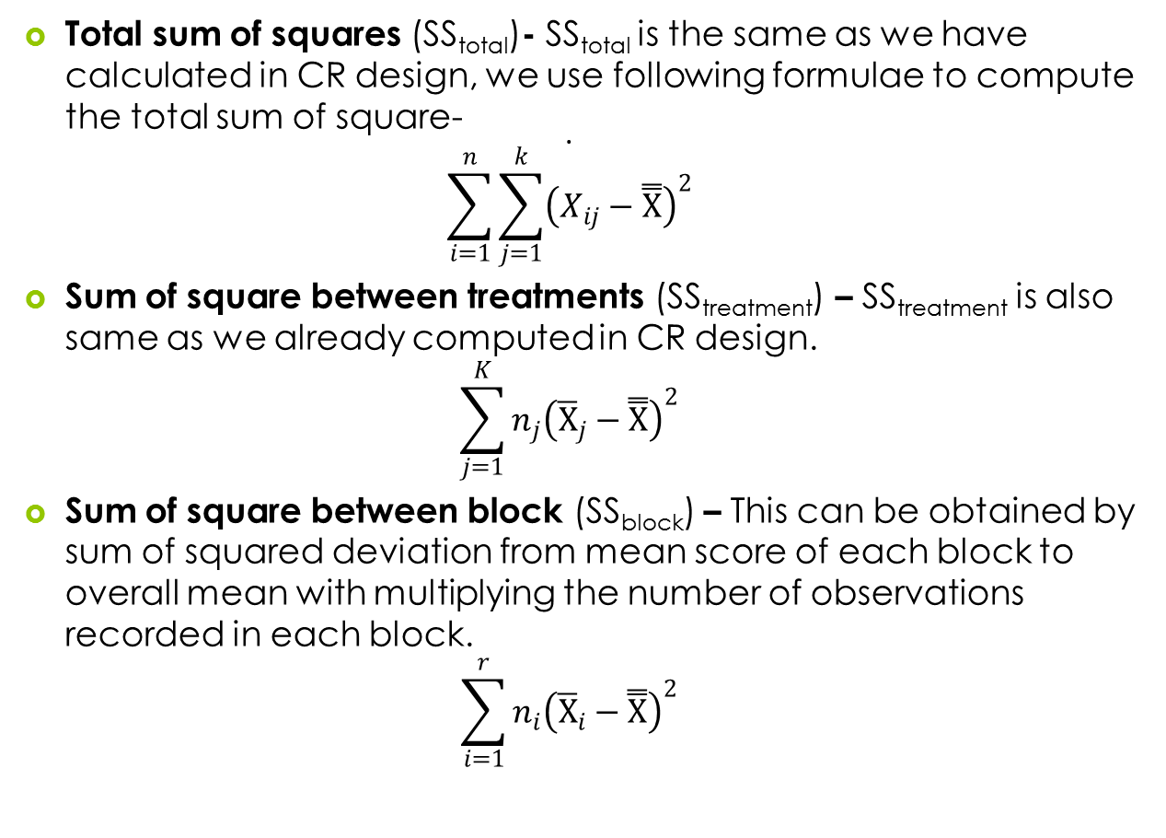
Important Calculations in RB Design

Slide 50
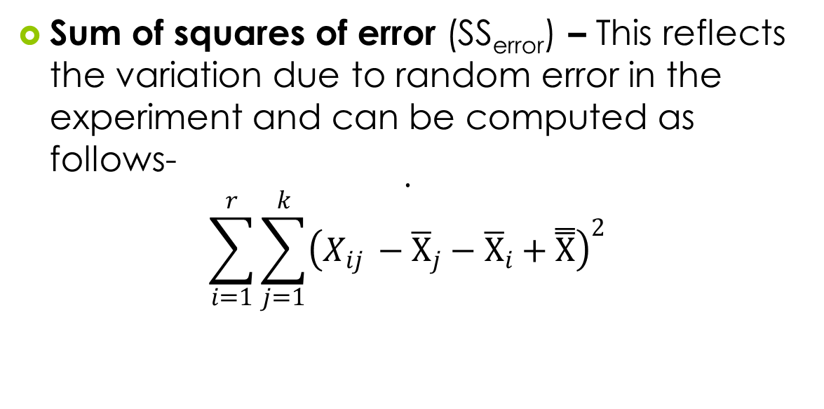

Slide 51
Computing Degrees of Freedom
Table 10.15. Degrees of Freedom: RBD
Variation Source | Formulae for Degrees of Freedom | df
Due to treatment | Number of treatment − 1, (k−1) | 3−1= 2
Due to block | Number of Block-1, (r−1) | 5−1=4
Error variance | n− [(k−1)−(r−1)−rk−1] | 105−2−4−8−1 = 90
Total variance | Number of observations−1, (n−1) | 105−1 = 104

Slide 52
Computing Mean Sum of Squares and F-Ratios
Table 10.16. F-Ratios: RBD
Formulae of Mean Sum of Square | Value | Formulae of F-Ratio | Value
Ms_{treatment =} SS_{treatment}/df | 40.5/2 = 20.25 | F_{treatment} = MS_{treatment}/ Ms_{error} | 20.5/6.96 = 2.90
Ms_{block =} SS_{block}/df | 94.80/4 = 23.70 | F_{block} = MS_{block}/ MS_{error} | 23.70/6.96 = 3.40
Ms_{error} = SS_{error}/df | 626.85/90 = 6.96

Slide 53
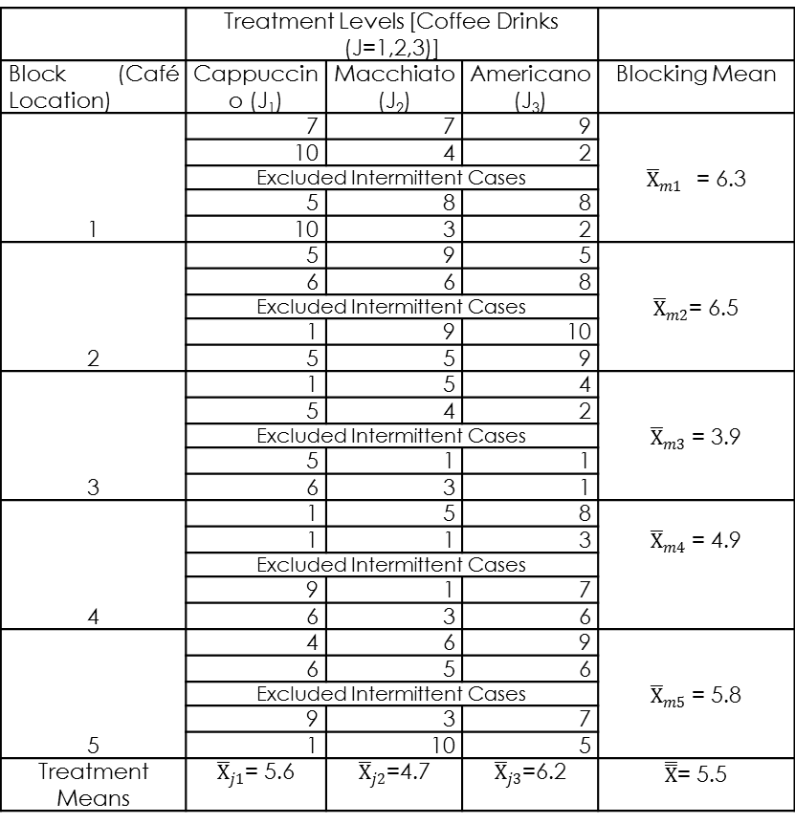
Sample Data Showing Mean Scores
Table 10.17. Different Mean Scores
 | Treatment Levels [Coffee Drinks (J=1,2,3)]
Block (Café Location) | Cappuccino (J₁) | Macchiato (J₂) | Americano (J₃) | Blocking Mean
1 | 7 | 7 | 9
 | 10 | 4 | 2
 | Excluded intermittent cases
 | 5 | 8 | 8
 | 10 | 3 | 2
2 | 5 | 9 | 5
 | 6 | 6 | 8
 | Excluded intermittent cases
 | 1 | 9 | 10
 | 5 | 5 | 9
3 | 1 | 5 | 4
 | 5 | 4 | 2
 | Excluded intermittent cases
 | 5 | 1 | 1
 | 6 | 3 | 1
4 | 1 | 5 | 8
 | 1 | 1 | 3
 | Excluded intermittent cases
 | 9 | 1 | 7
 | 6 | 3 | 6
5 | 4 | 6 | 9
 | 6 | 5 | 6
 | Excluded intermittent cases
 | 9 | 3 | 7
 | 1 | 10 | 5
Treatment means

Slide 54
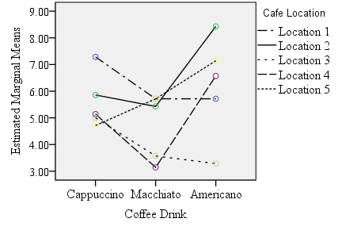
Graphical Interpretation
The line chart as displayed by SPSS facilitates an effective way to compare several means of treatment along with block as illustrated previously in the descriptive table.

Slide 55
Reporting the Results of One-Way ANOVA-RBD
The p-value associated with one-sample KS is more than 5 per cent LoS (p > 0.05, 0.61); hence, we retain the null hypothesis for condition of normality.
The p-values associated with F-statistic of treatment [F_{coffee drink} (2,90) = 2.90, p > 0.05, 0.06)] is more than 5 per cent LoS, hence we fail to reject the null hypothesis of treatment effect.
The p-values associated with F-statistic of blocks [F_{cafe location} (4,90) = 3.4, p < 0.05, 0.012)] is less than 5 per cent LoS.
Hence, we reject the null hypothesis of ‘no blocking effect’ and conclude that significant difference exists in quality due to different café location in that geographical area.

Slide 56
Key Terms
Analysis of Variance Blocking effect Completely Randomized Block Design error variance Explained variance Fixed-effects model F-ratios Independence of error Mean sum of square | Priori and posteriori contrasts Random effect Randomized Block Design Sum of square between groups Sum of square within groups Total variance Treatment effect Type I error rate Unexplained variance
Lokesh Jasrai (2020), SAGE TEXTS

